Slide 1
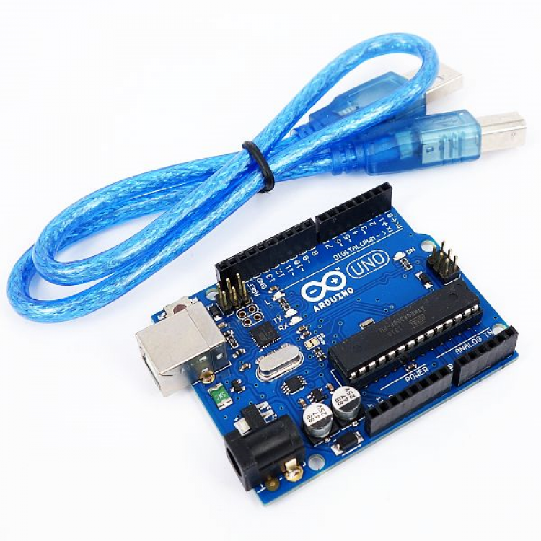


Create Arduino based Modbus RS485 Master & Slave module
Programming & Testing Arduino Uno

Slide 2
List of Hardware required
Arduino Uno board with USB cable
A RS 485 Shield for Arduino Uno
A LCD Display, preferable size 4x20
Some Connecting wires & hardwires

